Slide 1
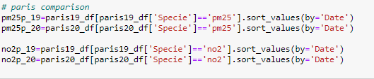
Data Process on PM2.5 and No₂ on 5 cities
Cities | Development | Population density
Pairs | High | Super High (21044/km²)
Brooklyn | High | High (14037/km²)
New Delhi | Medium | High (11050/km²)
Wu Han | Medium | Medium (2334/km²)
Melbourne | High | Low (516/km²)
Pollution major from construction and burning sources: PM2.5
Pollution major from traffic sources: No₂

Slide 2
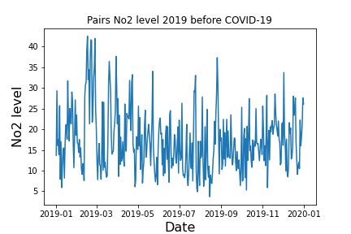
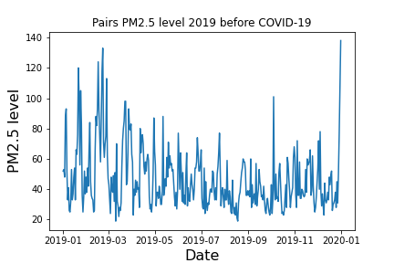
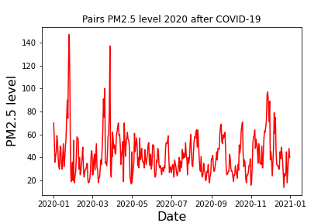
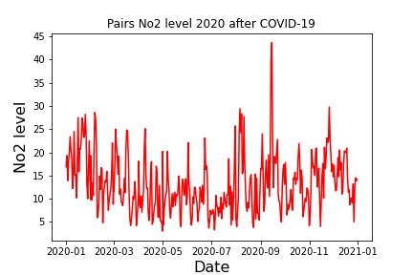
Paris

Slide 3
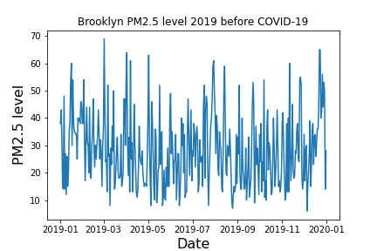
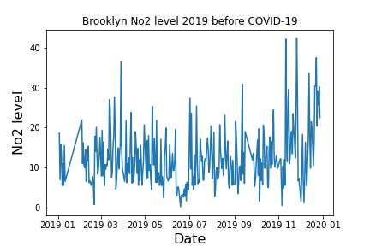
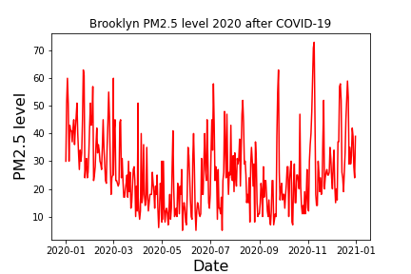
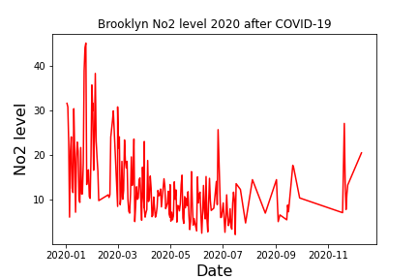
Brooklyn

Slide 4
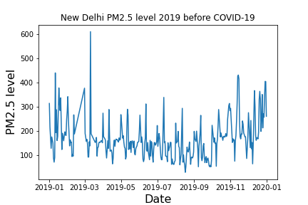
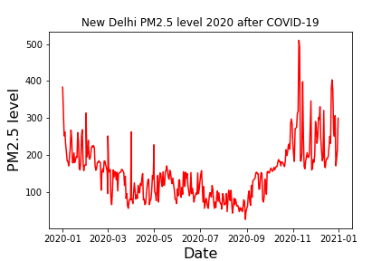
New Delhi

Slide 5
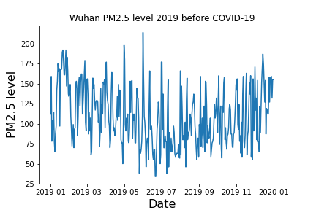
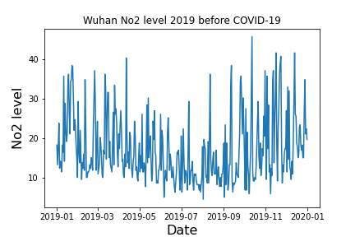
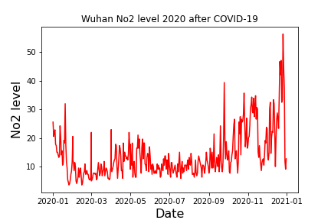
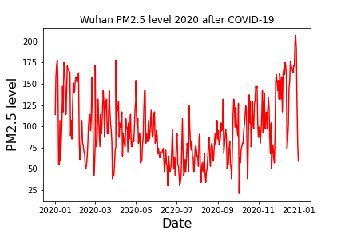
Wuhan

Slide 6
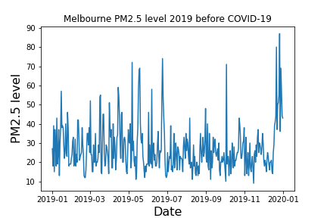
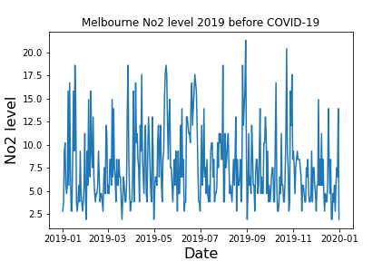
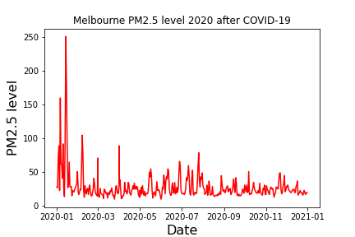
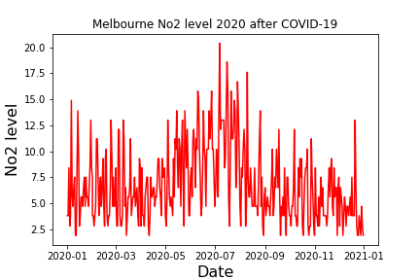
Melbourne

Slide 7
Summary value
Cities | PM2.5 2019 Before Covid | PM2.5 2020 After Covid | No2 2019 Before Covid | No2 2020 After Covid
New Delhi | 155 | 151
Paris | 40 | 38 | 16.4 | 12
Wuhan | 105.5 | 89 | 14.7 | 11.5
Melbourne | 24 | 23 | 6.5 | 5.6
Brooklyn | 27 | 24 | 10.9 | 10.4

Slide 8
Covid impact to cities
Covid generally improve the air quality for all cities
Higher impact on reducing in No₂ level than PM2.5, especially for more developed cities.
Data on air purification can tell a ‘true’ lockdown!
Cities from developing countries have large variation during Covid period

